Slide 1
Environmental technologies in Yara
October 14th, 2016

Slide 2


Slide 3
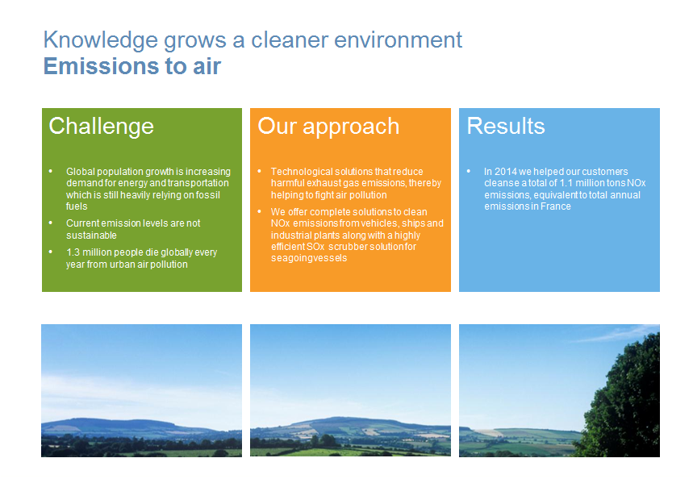

Slide 4
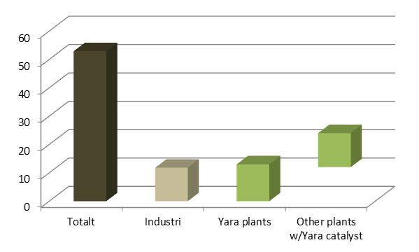
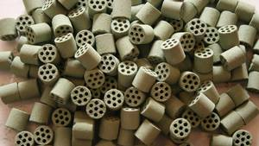
To reduce GHG emissions Yara developed a novel, ceramic N₂O abatement process catalysts in 1990s
Knowledge grows a cleaner environment
Catalyst development
Catalyst development created a unique competence in Yara through dedicated in-house R&D efforts
Obtained reductions in CO₂(eq) emissions from Yara N₂O abatement catalyst¹ equals 47% of total Norwegian emissions
53 mt
-12 mt
12 mt
-13 mt
Total
Industry
Catalyst
¹ https://www.ssb.no/natur-og-miljo/statistikker/klimagassn/aar-forelopige/2013-05-07

Slide 5
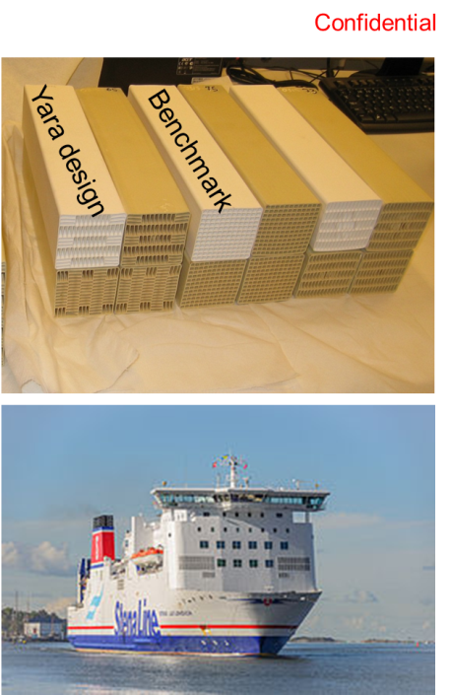
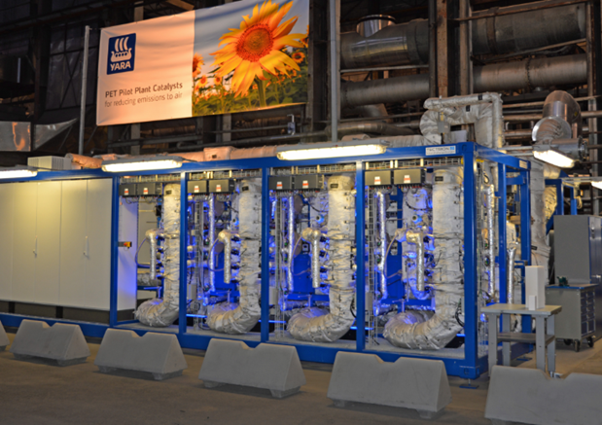
Knowledge grows a cleaner environment
Catalyst development
Building on existing catalyst competence Yara focus on a new business area
NOx catalyst
Co-funding from Innovation Norway enabled Yara to build one of the world’s most advanced pilot centres for catalyst development

Slide 6

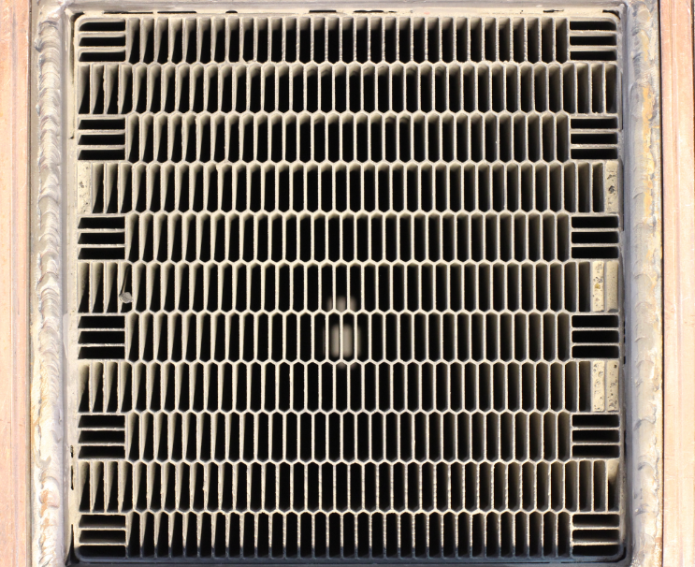
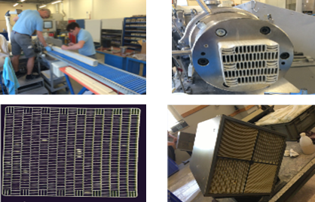
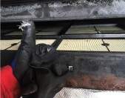


Customer value proposition
YARA’s new catalyst should provide several advantages for our clients and the environment
Less space requirement
Additional cabins on a cruise vessel
Create Value
Less space requirement
15% improvement to benchmark
No plugging risk and less backpressure
25% improvement to benchmark
No plugging risk and less backpressure
Leads to reduced fuel consumption
Saving operation cost
Less raw material consumption
10% improvement to benchmark
Less raw material consumption
Protect Environment

Slide 7
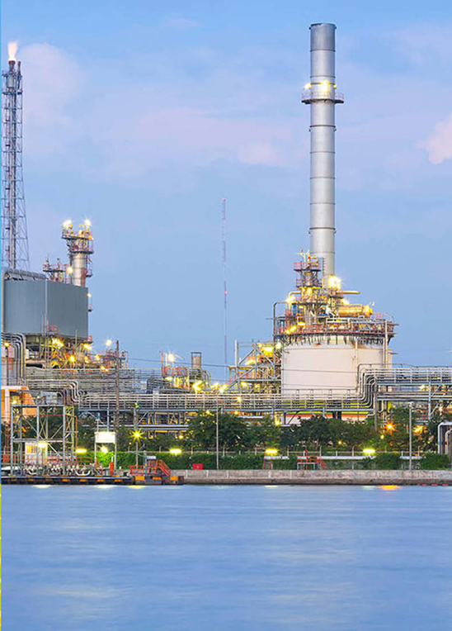
Knowledge grows a cleaner environment
Process emission reductions
Yara’s operations leads to emissions. We handle and abate emissions in different ways:
CO₂ emissions are partly captured and sold as valuable material
N2O emissions are abated and released as oxygen and nitrogen (= air)
NOx emissions are abated with catalyst or ammonia solutions (AdBlue)
Our abatement and process competence is used to develop a novel technology for fugitive emissions using ozone
NOx catalyst

Slide 8
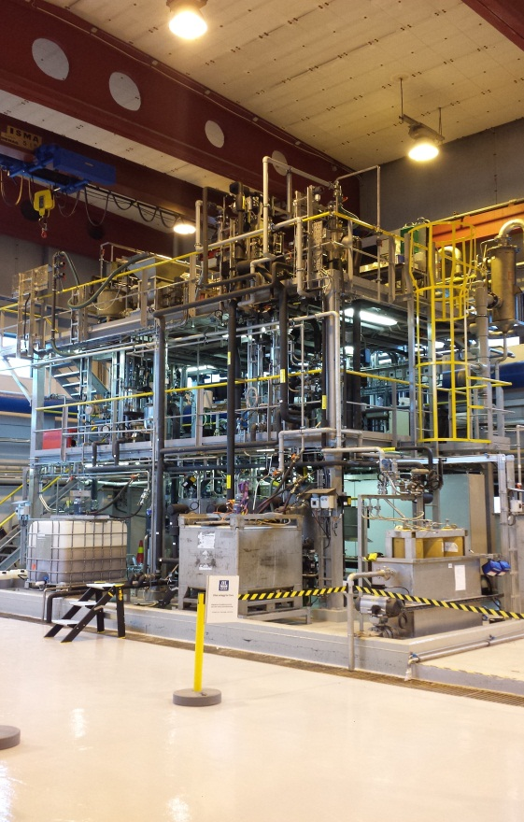
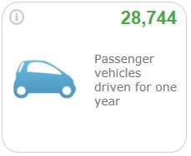
Knowledge grows a cleaner environment
Process emission reductions
Presently testing finalised in pilot plant, built with co-funding from Innovation Norway. Long term plants test next step
Yara’s R&D capabilities and process expertise set us apart from competitors
N₂O reduction by 85% =150 000 CO₂ eq

Slide 9


